Slide 1
Gender Inequality
Name
Institution of Affiliation
Professor
Date

Slide 2
Gender Inequality
Refers to the unfair or unequal treatment of a person which is based on their gender.
It is a worldwide problem and challenge affecting both developed and developing nations.
Affects female more than the male gender.
Women have become victims in the gender inequality more than men.

Slide 3
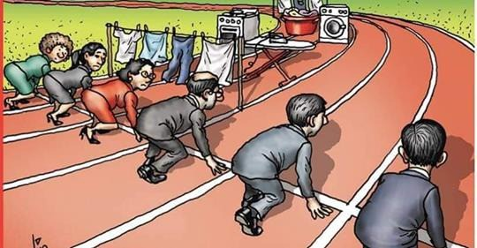

Slide 4
Forms Of Gender Inequality
Discrimination at work place
Biasness in work promotions
Inequality in education opportunities
Inequality in earnings
Property ownership inequalities
Inequality in health access among the women
Political leadership inequalities

Slide 5
Forms Of Gender Inequality Cont..
Gender based violence inequalities
Discrimination and biasness when raising a family
Family disputes inequalities

Slide 6
Nature Of Inequality Based On Culture
Women in some cultures are deemed inferior just by the nature of their gender
This is more evident among the African and the Asian communities
They are supposed to respect and take orders from the male gender
They cannot have a voice of their own

Slide 7
Workplace and Career
There are career that are deemed to be male oriented and women should not take such.
This has discouraged many women who may even do better than their male counterparts in the same field
This has led to a disparity even in the earnings for the female gender
Promotions among the women are very rare at the workplace.

Slide 8
Workplace and Career
The male gender still belief that women should not take leadership roles in the society just because they are female.
Women have been denied political leadership especially the elective positions because of such bias and inequality.

Slide 9


Slide 10
Why The Topic Is Important
Gender inequality data across the globe has proven the importance of having this discussion
Women are still suffering even in the 21st century due to this inequalities based on their gender
A lot of efforts have been made to ensure gender equity is achieved

Slide 11
Why The Topic Is Important
Despite the achievement, a lot needs to be done in order to achieve the equality among the two genders.
Changing societal perception is key in dismantling this menace of gender inequality.

Slide 12
Solutions to Gender Inequality
Share household chores
Have laws that govern against domestic violence
Develop protocols for promotion at work places
Pay salaries based on work done and not based on salaries
Zero tolerance on sexual harassments and racism

Slide 13
Solutions to Gender Inequality
Change society belief that male gender is superior to female gender
Start schools that cater for the disparity in education and academics for the girl child
Empower women in leadership by achieving the 3rd gender rule by UN

Slide 14
References
Heise, L., Greene, M. E., Opper, N., Stavropoulou, M., Harper, C., Nascimento, M., ... & Henry, S. (2019). Gender inequality and restrictive gender norms: framing the challenges to health. The Lancet, 393(10189), 2440-2454.
Blau, F. D. (2016). Gender, inequality, and wages. OUP Catalogue.
Huang, J., Gates, A. J., Sinatra, R., & Barabási, A. L. (2020). Historical comparison of gender inequality in scientific careers across countries and disciplines. Proceedings of the National Academy of Sciences, 117(9), 4609-4616.
Kleven, H., & Landais, C. (2017). Gender inequality and economic development: fertility, education and norms. Economica, 84(334), 180-209.
Batra, R., & Reio Jr, T. G. (2016). Gender inequality issues in India. Advances in Developing Human Resources, 18(1), 88-101.
Scott, S. (2018). Gender Inequality in America: Is it Here to Stay?.

Slide 15
References cont..
Fisher, B., & Naidoo, R. (2016). The geography of gender inequality. PLoS One, 11(3), e0145778.
Bukhari, M. A. H. S., Gaho, M. G. M., & Soomro, M. K. H. (2019). Gender Inequality: Problems & Its Solutions In Pakistan. The Government-Annual Research Journal of Political Science., 7(7).
Ryabokon, I. (2016). Gender inequality and the quality of work life in Ukraine. Zeszyty Naukowe Polskiego Towarzystwa Ekonomicznego w Zielonej Górze, 3(4), 204-217.
Newton, D. E. (2019). Gender Inequality: A Reference Handbook. ABC-CLIO.
Kim, J., Lee, J. W., & Shin, K. (2016). A model of gender inequality and economic growth. Asian Development Bank Economics Working Paper Series, (475).

